Slide 2

Unit 13: Implementing Security in your
Application

Slide 3
Lesson Objectives
After completing this lesson, you should be able to:
Explain how to secure your application
Describe authentication and authorization
Create and use an authentication scheme for your application
Create and attach an authorization scheme to your application, page, or components
Notes:
Oracle APEX is designed to build web apps that are highly secure out of the box. While administrators are primarily responsible for ensuring the security of the Oracle Application Express installation, developers are responsible for building secure applications. In this lesson, you learn how to utilize the built-in features available in Application Express to build a secure Web application.

Slide 4



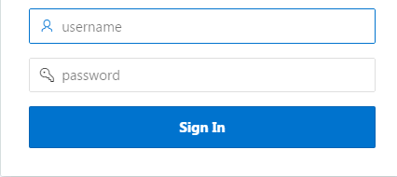


How to Secure an APEX Application?
Access Allowed
Authentication
Restricted
Who are you?
Authorization
What are you allowed to do after logging in?
Notes:
Once you create an application, you generally need to ensure that only authorized users can access the application, unless it is an open (public) application. That is, you want to implement security into your application. To ensure developers build a secure application, Application Express provides two different mechanisms: Authentication and Authorization.
The primary thing in building a secure web application is to understand who the accessing user is. You use a log in page with username and password as an access entry to an application. Only if the log in succeeds, the user is allowed access to the application. Confirming user's identity before allowing access to the application, is known as authentication.
After successfully logging in to the application, the next question is, what is that logged in user allowed to do? Can the user get access to a page, or a page component? Authorization covers this aspect of implementing security in an application. Authorization refers to restricting access to specific pages and components based on user privileges.

Slide 5



Establishing User Identity through Authentication
Authentication is the process of establishing each user’s identity before they can access your application
Many authentication processes requires users to provide credentials such as username and password
APEX engine uses APP_USER to track each user’s session state
Valid credentials
Access to the application
Invalid credentials
User provides log in credentials
No access to the application
APEX engine validates the credentials
Notes:
Authentication is the process of establishing each user's identify before they can access your application. It may require a user to enter a user name and password or could involve the use of digital certificates or a secure key.
You determine how your application interacts with users. If all users have the same rights and privileges, they are referred to as public users. However, if your application must track each user individually, you must specify an authentication method. Authentication establishes the identity of each user who accesses your application. Many authentication processes require that a user provide some type of credentials such as a user name and password. These credentials are then evaluated and they either pass or fail. If the credentials pass, the user has access to the application. Otherwise, access is denied.
Once a user has been identified, the Application Express engine keeps track of each user by setting the value of the built-in substitution string APP_USER. As a user navigates from page to page, the Application Express engine sets the value of APP_USER to identify the user. The Application Express engine uses APP_USER as one component of a key for tracking each user's session state.
Note: Built-in Authentication schemes are provided for Single Sign-On (SSO), LDAP, HTTP Header Variable authentication (used by Oracle Identity Manager), and Social Sign-In.

Slide 6
How to Implement Authentication?
In Application Express, you can create authentication by:
Selecting a built-in authentication scheme
Creating a custom authentication scheme
Notes:
As you create your application, you must determine whether to include authentication. If you choose not to use authentication, Oracle Application Express does not check any user credentials. All pages of your application are accessible to all users.
You can:
Select a built-in authentication scheme. Create an authentication method based on available preconfigured authentication schemes. Depending on which scheme you choose, you may also have to configure the corresponding components of Oracle 11giAS, Oracle Internet Directory, or other external services.
Create custom authentication scheme. Create a custom authentication method to have complete control over the authentication interface. To implement this approach, you must provide a PL/SQL function the Application Express engine executes before processing each page request. This function's Boolean return value determines whether the Application Express engine processes the page normally or displays a failure page.
When you create a new authentication scheme, you have several options. Most let you reuse implementations that already exist in your application or in other applications within your workspace. There are even some pretested schemes you can copy to get you up and running immediately.

Slide 7
Understanding Preconfigured Authentication Schemes
Oracle Application Express supports the following preconfigured authentication schemes:
Open Door Credentials
Application Express Accounts
Database Accounts
LDAP Directory
No Authentication (Using DAD)
Oracle Application Server Single Sign-On
Custom
HTTP Header Variable
Social Sign-In
Notes:
The following preconfigured schemes ship with Oracle Application Express:
Open Door Credentials: Enables anyone to access your application using a login page that captures a user name.
Application Express Accounts: Application Express Account Credentials are internal user accounts (also known as "cookie user" accounts) that are created within and managed in the Application Express user repository. When you use this method, your application is authenticated against these accounts.
Database Accounts: This authentication scheme requires that a database user (schema) exists in the local database. When using this method, the user name and password of the database account is used to authenticate the user.
LDAP Directory: Authentication of user/password with an authentication request to a LDAP server.
No Authentication (Using DAD): Adopts the current database user. This can be used in combination with a mod_plsql DAD configuration that uses basic authentication to set the database session user.
Oracle Application Server Single Sign-On: This delegates authentication to the Oracle AS Single Sign-On (SSO) Server. To use this authentication scheme, your site must have been registered as a partner application with the SSO server.
Custom: Enables you to create a custom authentication scheme from scratch, giving you complete control over your authentication interface.
HTTP Header Variable: Authenticate externally, where the username is stored in a HTTP Header variable set by the web server.
Social Sign-In: Supports authentication with Google, Facebook, and other social network that supports OpenID Connect or OAuth2 standards.
Note: Social Sign-In authentication is primarily useful for the following use cases:
Your application is internet facing and you expect an unknown number of users from social networks to use your application.
Your company has standardized on one of these providers, Oracle Identity Cloud Service, an internal OpenID Connect or OAuth2 system for authentication.

Slide 8
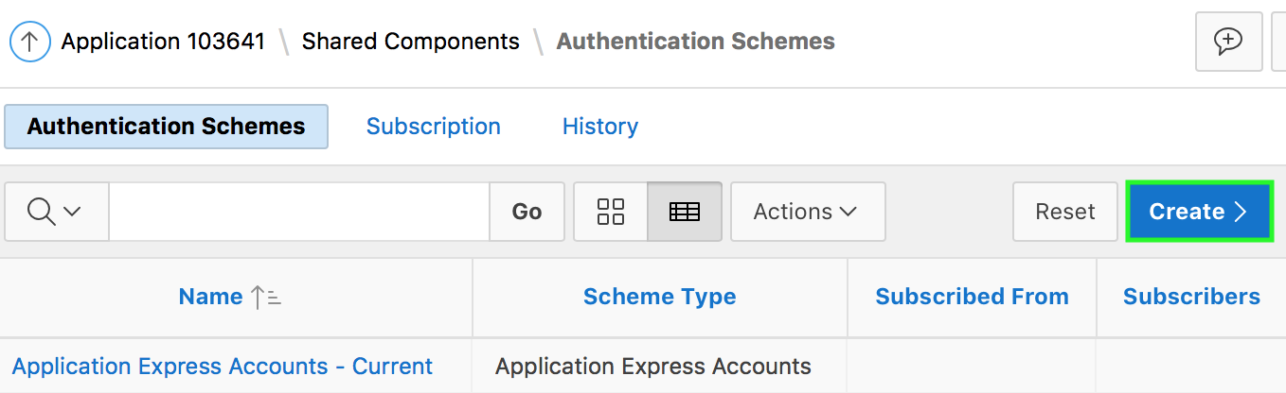
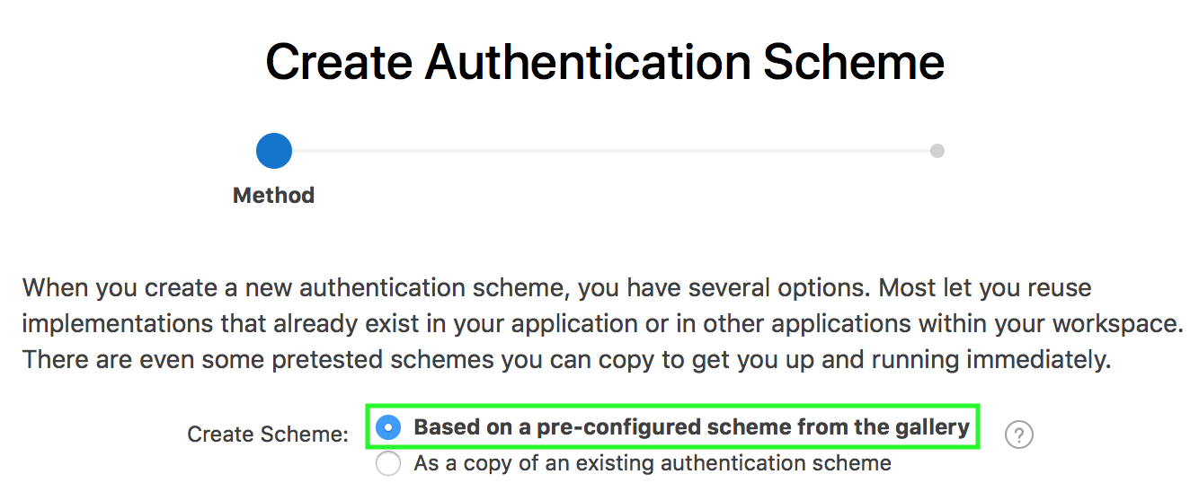
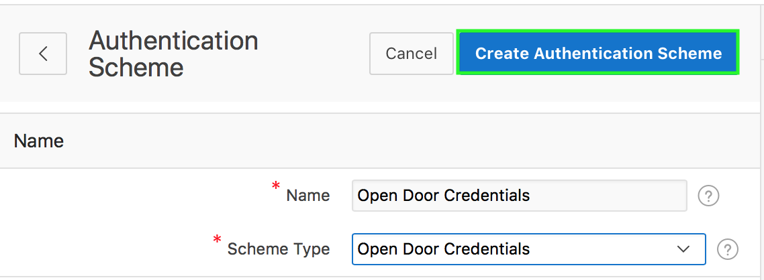
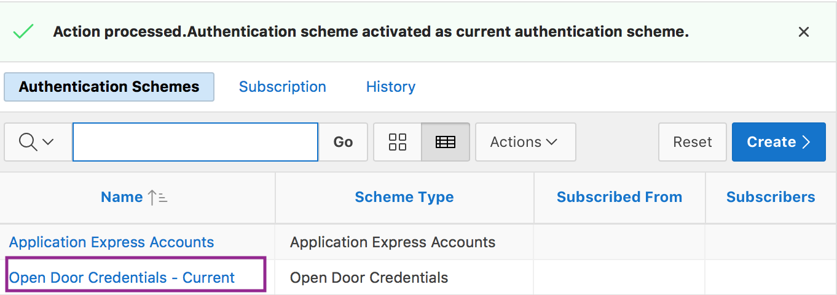
Creating an Authentication Scheme Based on a Pre-configured Scheme
2
1
3
4
Notes:
To create an authentication scheme based on a pre-configured scheme, first navigate to your application home page. Then, click Shared Components > Security and then select Authentication Schemes. Perform the following steps:
On the Authentication Schemes page, click Create.
Select the Based on a pre-configured scheme from the gallery radio button and click Next.
Specify a name for your authentication scheme. Then, select a scheme of your choice from the Scheme Type list. Click Create Authentication Scheme.
Notice that the new authentication scheme is activated as current authentication scheme.

Slide 9
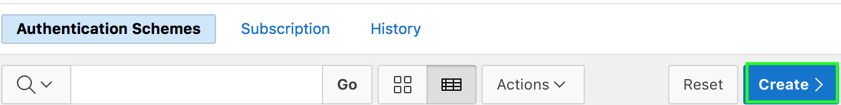
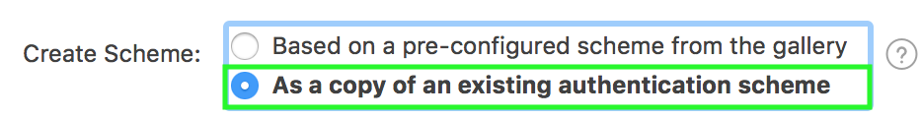
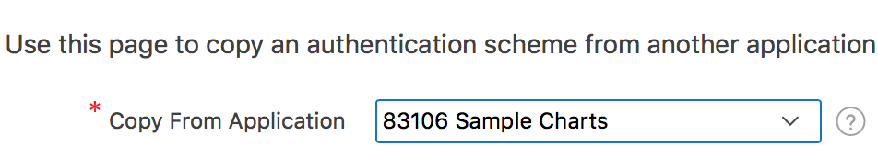
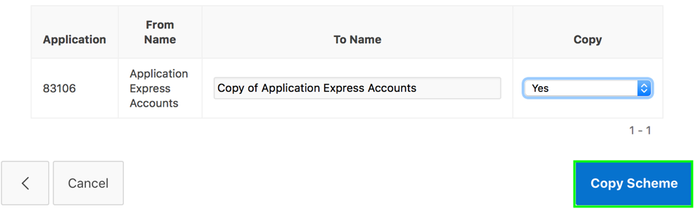
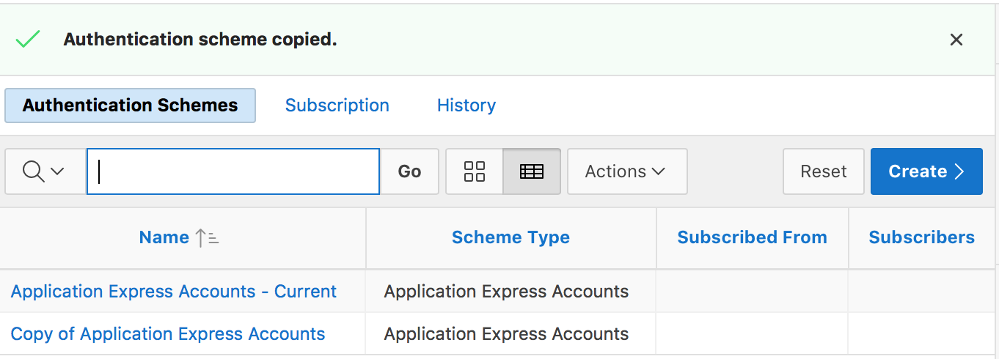
Creating a Copy of an Existing Authentication Scheme
1
2
3
4
5
Notes:
You may create a new authentication scheme by making a copy of a scheme in your application or in any another application in your Workspace. Then you can edit the new scheme, changing the name to what you prefer and changing any of the settings to meet your requirements.
To create a copy of an existing authentication scheme, first navigate to your application home page. Then, click Shared Components > Security and then select Authentication Schemes. Perform the following steps:
On the Authentication Schemes page, click Create.
Select As a copy of an existing authentication scheme and click Next.
Select the application from which you want to copy the scheme and click Next.
The schemes existing in the selected application are now listed on the page. Select Yes for the scheme that you want to copy. You can choose to copy or copy and subscribe to an authentication scheme in the application you select as the copy source. Subscribing to an authentication scheme puts a copy of it in your application but allows you to refresh it periodically to get the latest changes. Click Copy Scheme.
The Authentication Schemes page now shows the copied application. On this page, you can also see the scheme current to this application.

Slide 10

Providing Security Through Authorization
Authorization involves controlling access to resources based on user privileges
Use authorization schemes to implement authorization in an application
You can apply an authorization scheme for:
An entire application
A page
Specific control such as a region, item, or button
Notes:
Authorization is a broad term for controlling access to resources based on user privileges. While conditions control the rendering and processing of specific page controls or components, authorization schemes control user access to specific controls or components.
An authorization scheme extends the security of your application's authentication scheme. You can specify an authorization scheme for an entire application, page, or specific control such as a region, item, or button. For example, you could use an authorization scheme to selectively determine which tabs, regions, or navigation bars a user sees.
Before you associate an authorization scheme with an application, application component or control, you must first create it.
An authorization scheme either succeeds or fails. Common authorization scheme types include Exists, Not Exists SQL Queries, and PL/SQL Function Returning Boolean. If a component or control level authorization scheme succeeds, the user can view the component or control. If it fails, the user cannot view the component or control. If an application or page-level authorization scheme fails, then Oracle Application Express displays a previously defined message.
When you define an authorization scheme, you give it a unique name. Once defined, you can attach it to any component or control in your application. To attach an authorization scheme to a component or control in your application, simply navigate to the appropriate attributes page and select an authorization scheme from the Authorization Scheme list.

Slide 11
How to Implement Authorization?
Oracle Application Express allows you to implement authorization to an application or its components in two different ways:
By navigating to Shared Components and then either creating an authorization scheme from scratch or copying an existing authorization scheme
By creating an Access Control Page and then performing the following steps:
Configuring the Access Control Page:
Setting the application mode
Adding users to the Access Control List
Applying the authorization scheme to application components
Notes:
You can create and apply an authorization scheme to an application and its components using two different ways:
Navigate to Shared Components > Authorization and then create an authorization scheme from scratch or by copying an existing authorization scheme
Create an Access Control page, set the application mode and then add users to the Access Control List. Then, you apply the authorization scheme to application components

Slide 12
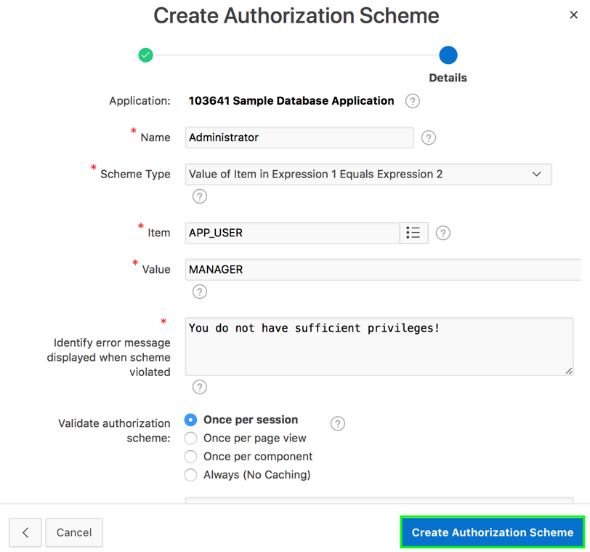
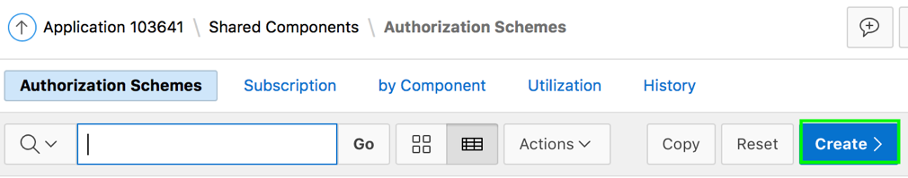
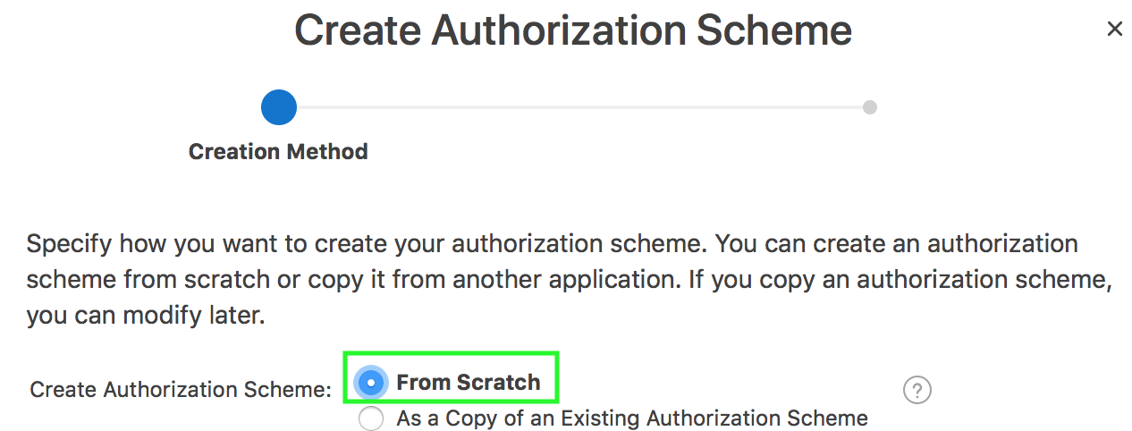
Creating an Authorization Scheme from Scratch
3
1
2
Notes:
When you create an authorization scheme, you select an authorization scheme type. The authorization scheme type determines how an authorization scheme is applied. Developers can create new authorization type plug-ins to extend this list.
To create an authorization scheme, navigate to your application home page, click Shared Components. Under Security, select Authorization Schemes and then perform the following steps:
On the Authorization Schemes page, click Create.
For Create Authorization Scheme, select From Scratch and click Next.
On Create Authorization Scheme:
Name - Enter an unique name that identifies this authorization scheme. In the slide example, enter Administrator.
Scheme Type - Select how this authorization scheme will be applied. In the slide example, select Value of Item in Expression 1 Equals Expression 2. The authorization succeeds if the item's value equals the authorization value. In the slide example, select APP_USER for Item, and enter MANAGER for Value. That is, in the example, the value in Expression 1 (APP_USER) is compared to the value specified in Expression 2 (MANAGER).
Identify error message displayed when scheme violated - Enter error text that displays if the authorization scheme fails (that is, the current user fails the security check).
Validate Authorization Scheme - Authorization schemes are evaluated on first use in a session. Use this option to controls if future uses cause re-evaluations and when a memorized result can be taken instead.
Click Create Authorization Scheme.

Slide 13
Understanding Access Control
You control access to an app, individual page, or page components by creating an access control list
When you run the Access Control Wizard, it creates multiple pages and the following components:
Adds an Access Control region to the Administration Page you specify
Creates the access roles: Administrator, Contributor, and Reader
Creates the authorization schemes: Administration Rights, Contribution Rights, and Reader Rights
Creates the build option, Feature: Access Control
Creates the Application Setting, ACCESS_CONTROL_SCOPE
You use the access control list to associate the access roles with application users
Notes:
Adding the Access Control feature to an application, creates multiple pages and the components as explained in the slide. Developers use the access control list to associate the privileges, view, edit, and administration, with application users. Within the final Access Control UI, each privileges correlates to an access role:
View correlates to the Reader role.
Edit correlates to the Contributor role.
Administration correlates to the Administrator role.

Slide 14
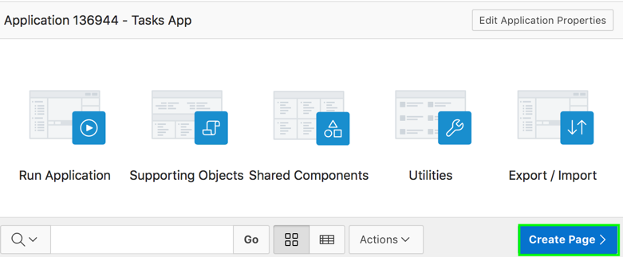
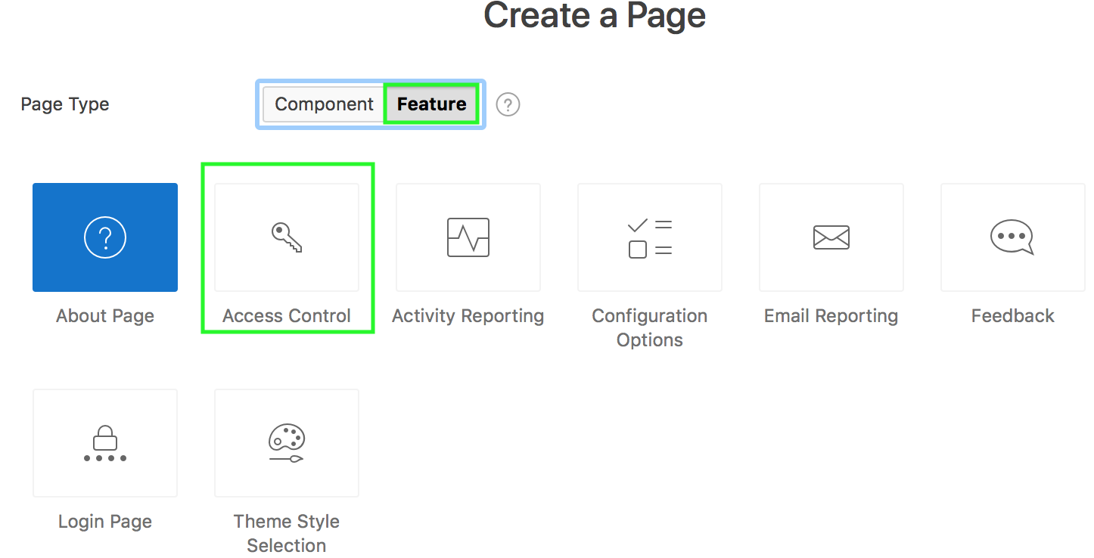
Creating the Access Control Administration Page
1
2
Notes:
The slide shows the steps involved in creating an access control list by creating a page. You can create an access control list using either the Create Application Wizard or the Create Page Wizard. In the Create Application Wizard, for Features, you select Access Control check box.
You create an access control list by running the Create Page Wizard from the Application home page. You can also run this wizard in Page Designer by clicking the Create menu and selecting Page.
To create an access control list from the Application home page, perform the following steps:
Navigate to your application home page and click Create Page.
Select Feature and then select Access Control for Page Type. Then, click Next.

Slide 15
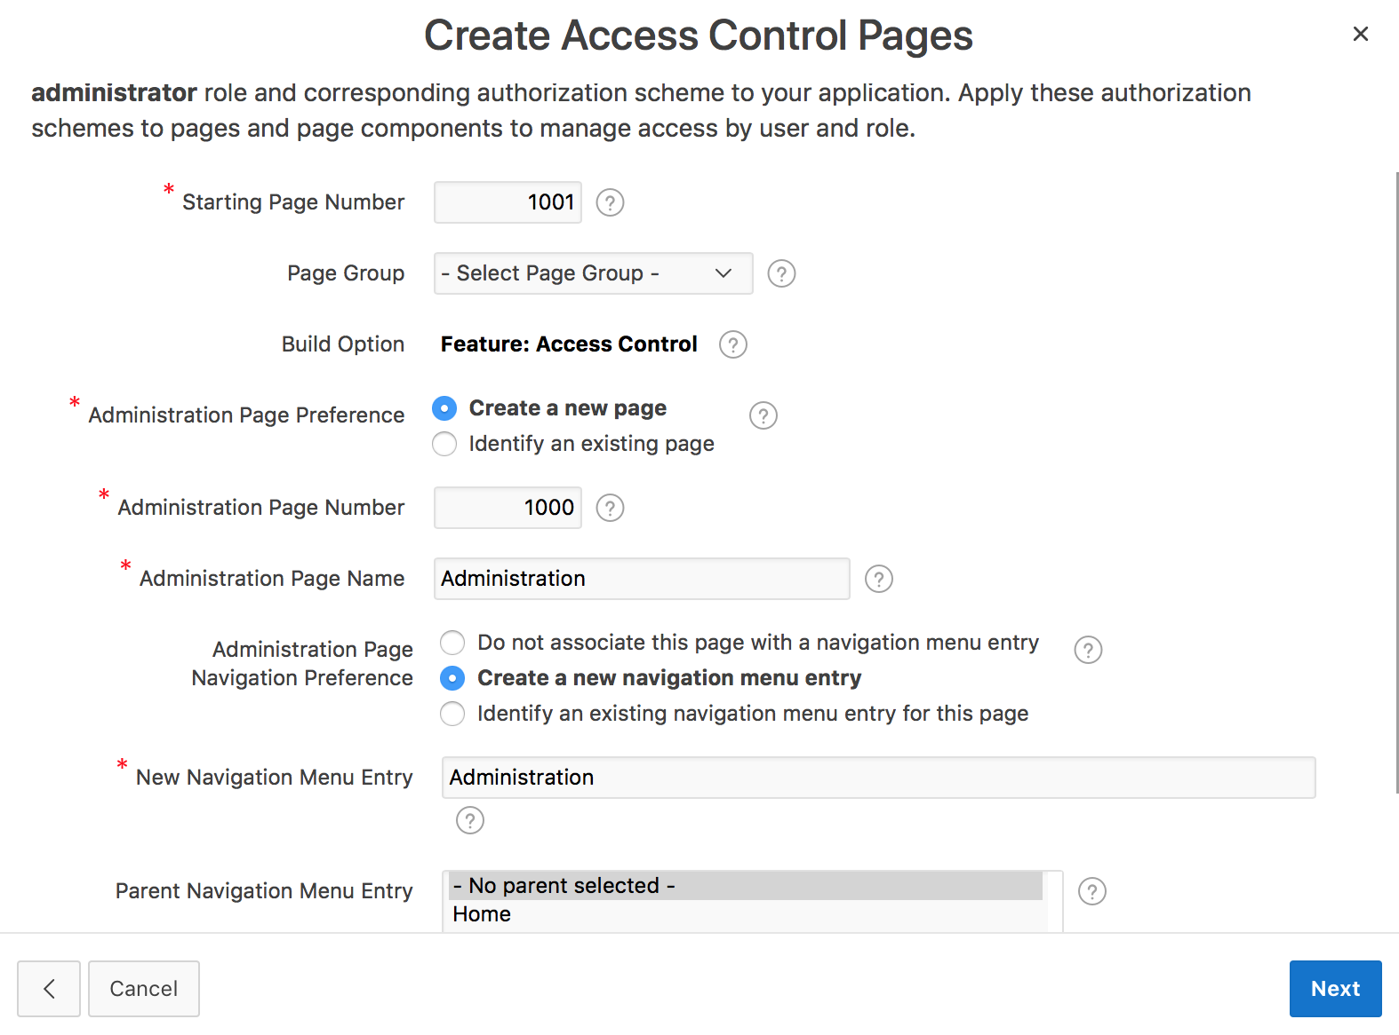
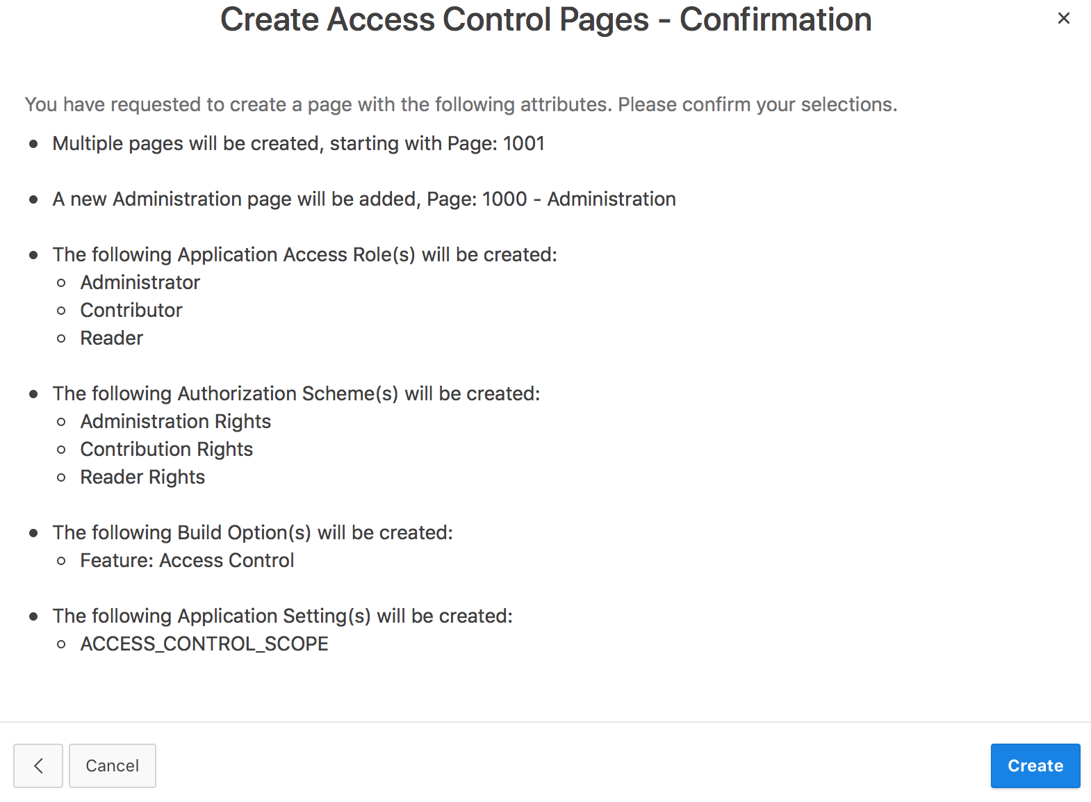
Creating the Access Control Administration Page
4
3
Notes:
For Starting Page Number, specify an unused page number. Select your preference for Administration Page Preference and enter a name for Administration Page Name. Specify your preference for navigation and click Next.
Review the confirmation page and click Create.

Slide 16
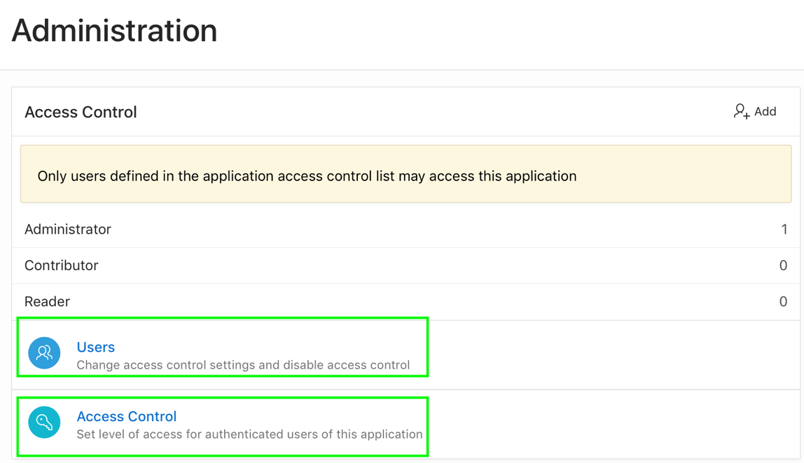
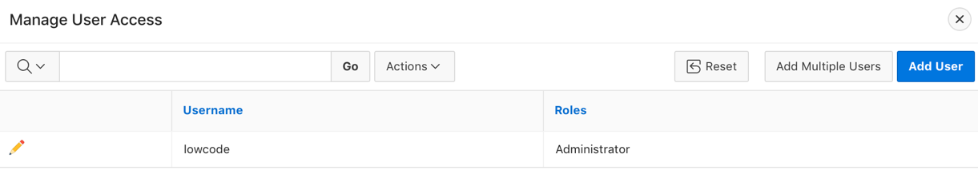
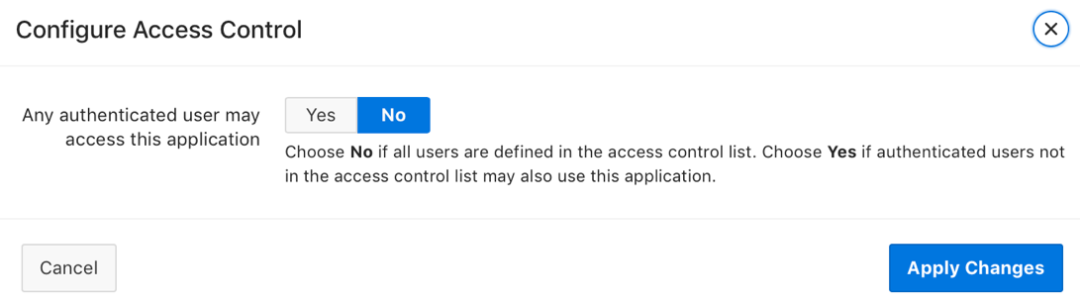
Configuring Access Control
1
Run the Administration page
2
Add users to the Access Control List
Specify the behavior when authenticated uses access your app
3
Notes:
Once you add the Access Control feature, you configure it by running the application and accessing the Access Control region on the Administration page. The Access Control region lists currently defined access roles and contains two sections: Users and Access Control.
Run the Access Control Administration page.
Now, you add users to the Access Control List. To add users to the Access Control List, perform the following steps:
Click Users.
The Manage User Access dialog appears. Click Add User. A new row appears.
Enter a user in the Username field.
Associate a privilege with the user. Available options include:
Administrator
Edit
View
Click Add User. Repeat steps a-d for all users.
You can set the level of access for authenticated users of your application. Click Access Control. The Configure Access Control dialog appears. Choose No if all users are defined in the access control list. Choose Yes if authenticated users not in the access control list may also use this application. Click Apply Changes.
Note:
Since roles are applied to users, you must create the roles before adding users.
Application users are not exported as part of your application. When you deploy your application you will need to manually manage your user to role assignments. Roles are exported as part of an application export and imported with application imports.

Slide 17
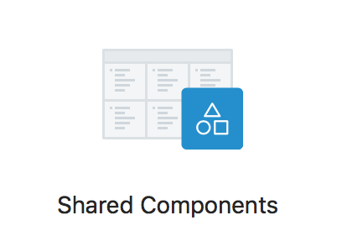
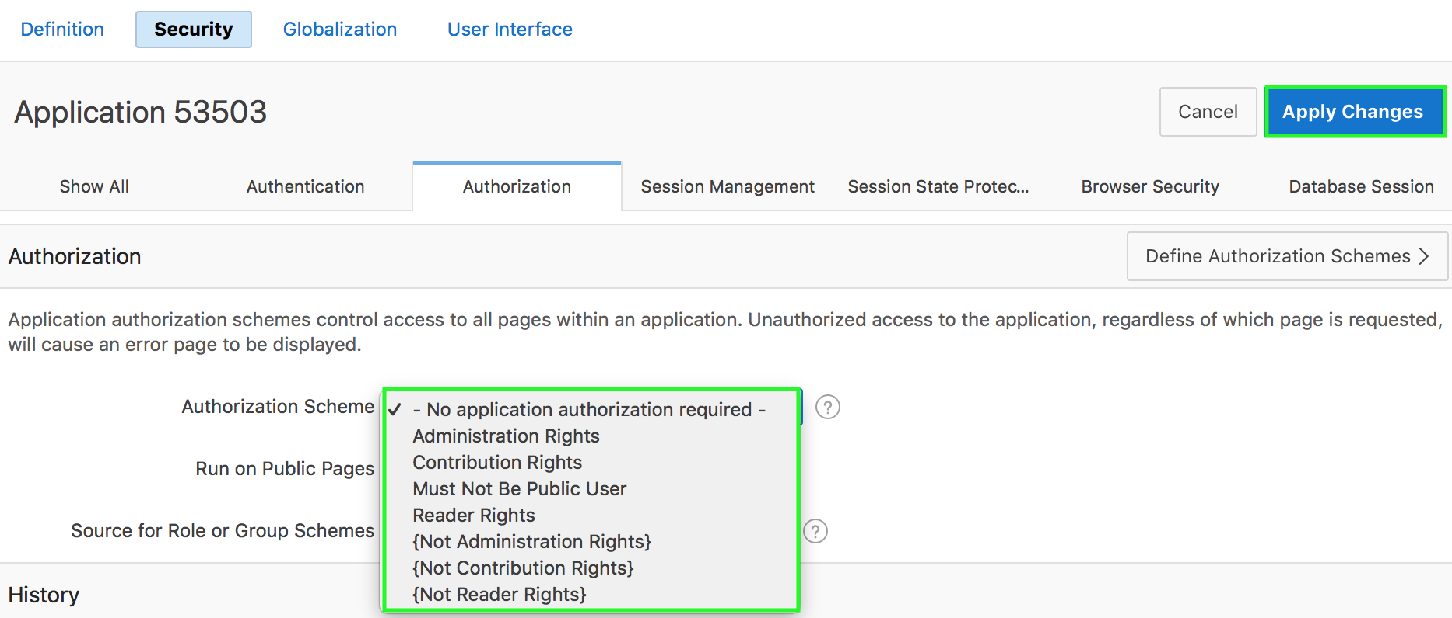
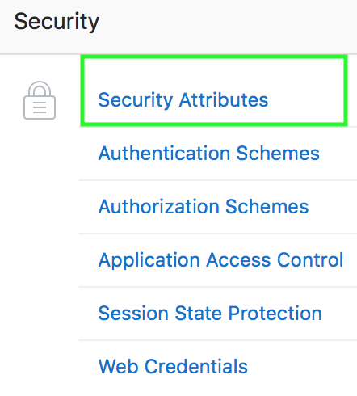
Attaching an Authorization Scheme to an Application
1
3
2
Notes:
Application authorization schemes are defined for an application for the purpose of controlling access. Setting a required authorization scheme at the application level will require all pages of the application to pass the defined authorization check.
The slide shows steps to attach an authorization scheme to an application. Perform the following steps:
Navigate to your application home page and click the Shared Components icon. The Shared Components page appears.
Under Security, click Security Attributes.
Scroll down to Authorization and make a selection from the Authorization Scheme list. For Run on Public Pages, select Yes or No to specify whether the application-level authorization scheme is checked on public pages (that is, pages that do not require authorization). Click Apply Changes.
To define a new authorization scheme, click Define Authorization Schemes.

Slide 18
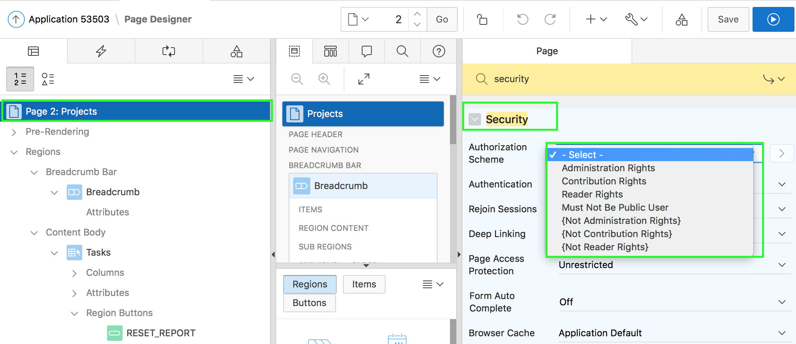
Attaching an Authorization Scheme to a Page
Notes:
To attach an authorization scheme to a page, perform the following steps:
Navigate to the page definition of the page to which you want to attach the authorization scheme.
Under Rendering, select the page name.
In the Property Editor, scroll down to Security. From the Authorization Scheme list, select a scheme. For the page to be rendered, this authorization scheme must evaluate to TRUE.
Click Save. Then, Click Save and Run Page.
An authorization scheme is evaluated either once for each application session (at session creation), or once for each page view. If the selected authorization scheme evaluates to TRUE, then the page displays and is subject to other defined conditions. If it evaluates to FALSE, then the page does not display and an error message displays.

Slide 19
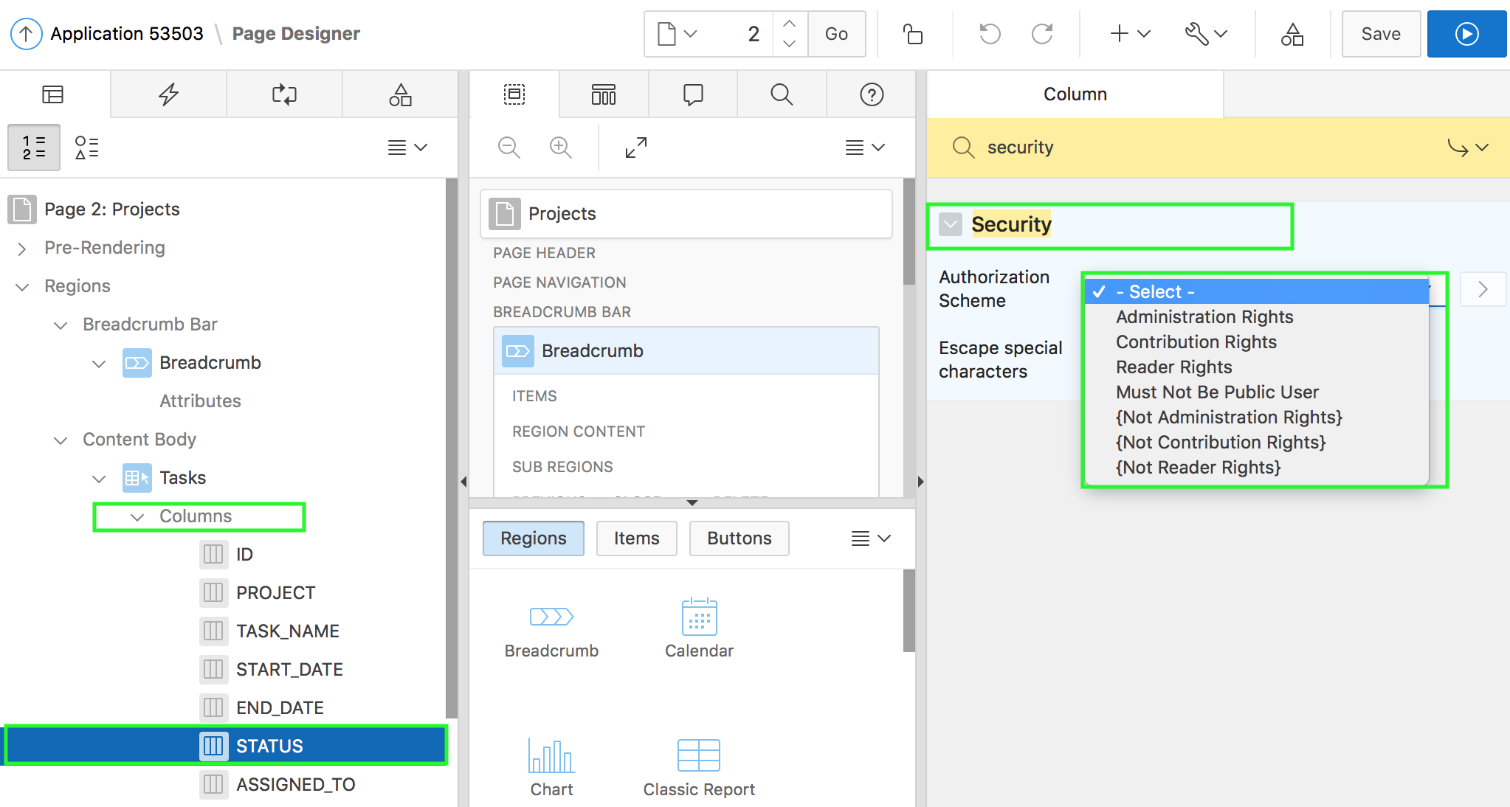
Attaching an Authorization Scheme to a Control or Component
Notes:
To attach an authorization scheme to a page component or control, perform the following steps:
In your application, select a page. View the page in page designer.
Click the name of the component or control to which you want to apply the authorization scheme.
In the Property Editor, scroll down to Security and make a selection from the Authorization Scheme list.
Click Save.
The slide shows applying an authorization scheme to a column in an interactive report page. In page designer, expand columns, select the column for which you want to attach the authorization scheme. Under Column Properties, navigate to Security and select an authorization scheme from the list.

Slide 20
Summary
In this lesson, you learned how to:
Create and use an authentication scheme for your application
Create and apply an authorization scheme to your application, page, or components

Slide 21


Slide 22
Hands-on Lab

